Slide 1


Species distribution models (SDM) – from a computer perspective
DR
Nuno César de Sá¹,
¹ Institute of Environmental Sciences (CML)
Systematics & Biodiversity, 2020

Slide 2
Remember where we are:
Occurrence
Algorithm
Validation
Predictions
Performance
Enviroment
What are SDM’s for a computer?
How does it understand the niche?
How does it predict?

Slide 3
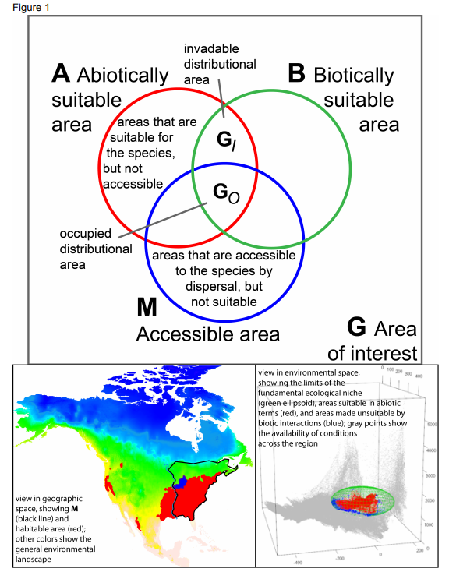
SDM – from a computer perspective
Defining Ecological Niches: Hutchinson
n-dimensional Environmental space (“hyperspace“)
Sóberon & Peterson: Abiotic, Biotic, Movement
Geographic space (where they are) vs Niche space (why they are there)
From a more formal point of view:
$$EN\left(species\right)=f(Abiotic, Biotic, Movement)$$
From: https://doi.org/10.1515/eje-2015-0014

Slide 4
SDM – from a computer perspective
Defining Ecological Niches: Hutchinson
n-dimensional Environmental space (“hyperspace“)
Sóberon & Peterson: Abiotic, Biotic, Movement
Geographic space (where they are) vs Niche space (why they are there)
From a more formal point of view:
But.. There is no “Ecological niche value” (EN)
And also, no “f(A,B,M)”
Two competing approaches:
Probabilistic models “vs” Mechanistic models
$$EN\left(species\right)=f(Abiotic, Biotic, Movement)$$
From: https://doi.org/10.1515/eje-2015-0014

Slide 5
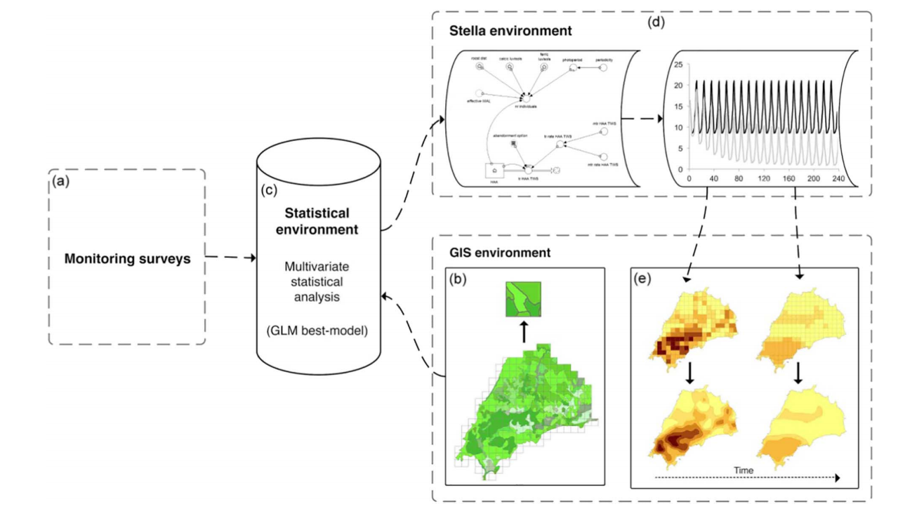
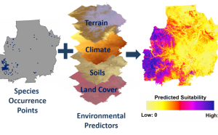
SDM – from a computer perspective
Two “competing” approaches: Focus will be on Probabilistic models
Mechanistic models
Probabilistic models
From: https://doi.org/10.1016/j.biocon.2017.04.013
From: https://www.natureserve.org/conservation-tools/habitat-suitability-modeling

Slide 6
SDM – from a computer perspective
Two “competing” approaches: Focus will be on Probabilistic models
Mechanistic models
Probabilistic models
Data
f(A,B,M)
Data
Results
Programming
Ecological
knowledge?
Machine Learning
Results
f_{aprox}(A,B,M)

Slide 7
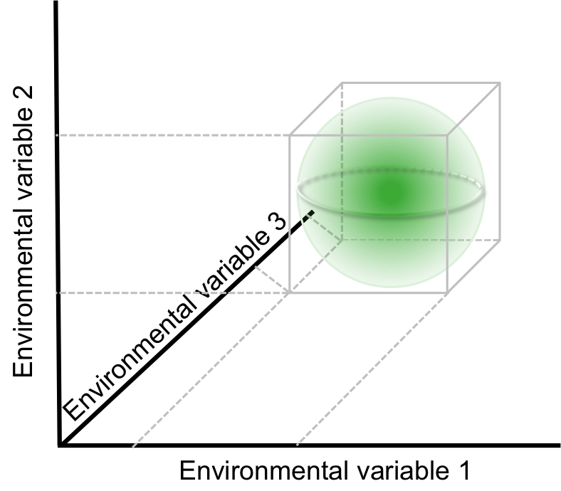
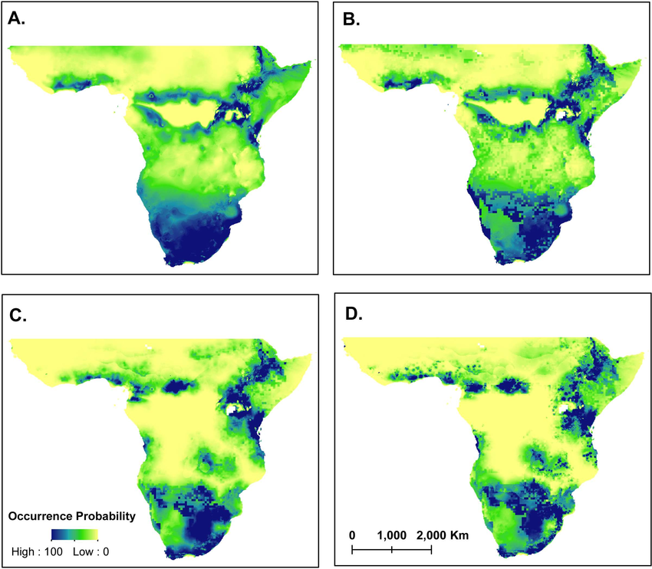

SDM – from a computer perspective
Environmental space – EN
Geographic space - EN projected by f(A,B,M)
$$f(A,B,M)$$
From: https://doi.org/10.4404/hystrix-27.1-11678
If the EN was a simple n-dimentional surface... It would be easy....

Slide 8
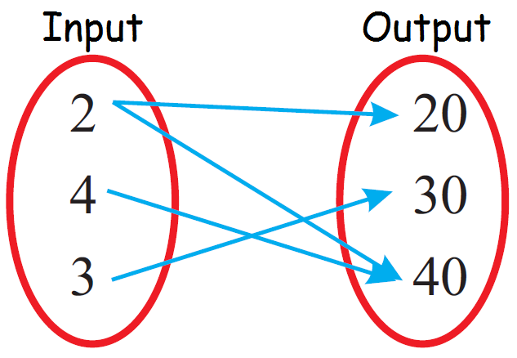
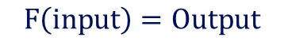
SDM – from a computer perspective
Machine learning:
At the core: learning a mapping function
Mapping function: “arbitrary” function Translates/transforms input values from one domain to another
$$F\left(input\right)=Output$$

Slide 9
SDM – from a computer perspective
Machine learning:
At the core: learning a mapping function
Mapping function: “arbitrary” function Translates/transforms input values from one domain to another
AKA: Ecological niche models; Habitat/Suitability modelling; Correlative models, Range mapping; etc
For ML people: Supervised learning
Commonly maps: N-dimensions onto 1D probability
PS: More common problem in supervised learning is to map N:M dimensions
$$F\left(input\right)=Output$$

Slide 10
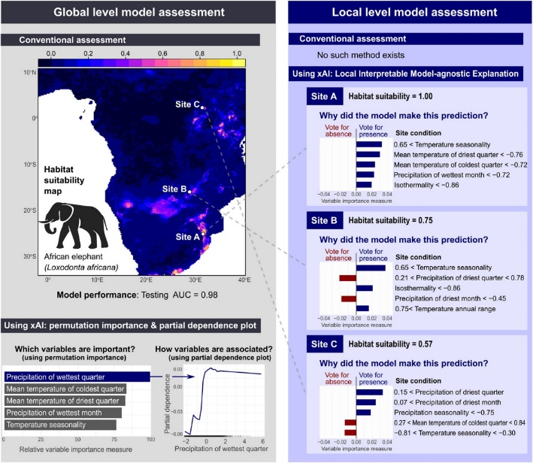
SDM – from a computer perspective
Machine learning:
At the core: learning a mapping function
Mapping function: “arbitrary” function Translates/transforms input values from one domain to another
AKA: Ecological niche models; Habitat/Suitability modelling; Correlative models, Range mapping; etc
For ML people: Supervised learning
Commonly maps: N-dimensions onto 1D probability
PS: More common problem in supervised learning is to map N:M dimensions
Risks: (Timnit Gebru)
Bad data -> bad model
Biases in data -> biases in the model
“black-box” (or maybe not... Increasingly debatable!)
$$F\left(input\right)=Output$$
Explainable AI is arriving! (PS: R code available!)
From: https://doi.org/10.1111/ecog.05360

Slide 11
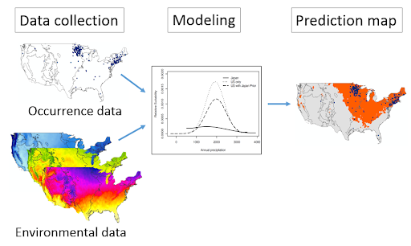
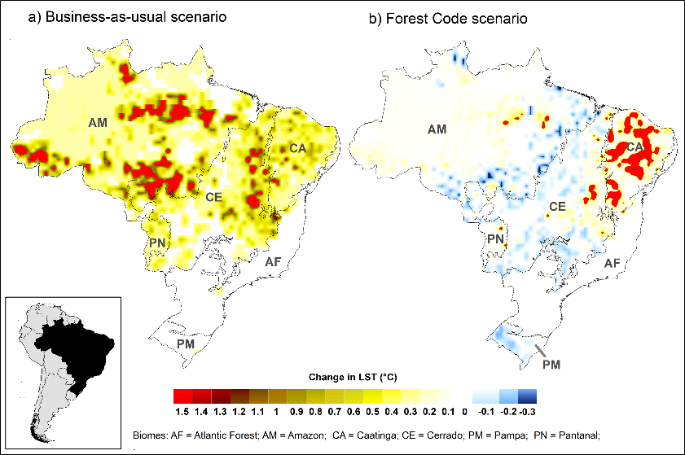
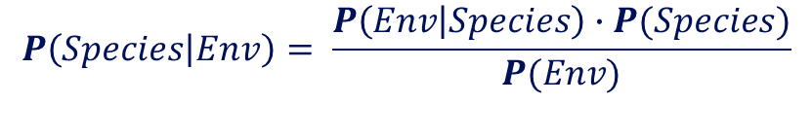
SDM – from a computer perspective
Having occurrence data and environmental data
we want to find the P(Species) being present given the environment
Formalizing from a Bayesian perspective:
Implies that: P(Species), P(Env) are independent
Objective: learn a function that maps environmental variables onto a 1D probability of occurrence
$$P\left(Species | Env\right)= \frac{P\left(Env | Species\right)∙P(Species)}{P(Env)}$$
But, are they?
From: https://doi.org/10.1371/journal.pone.0213368

Slide 12
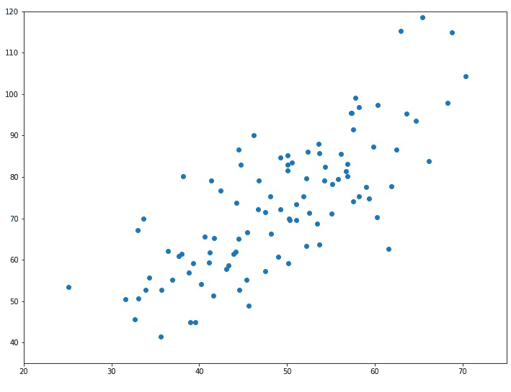
SDM – from a computer perspective
How do machines actually, learn?
Consider you are asked to find the best linear model that fits a set of data
And you skipped the linear algebra class
But you know that: Y =mX + C is a linear equation
And m is the “slope” and C is the “bias”

Slide 13
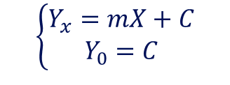
SDM – from a computer perspective
How do machines actually, learn?
Consider you are asked to find the best linear model that fits a set of data
And you skipped the linear algebra class
But you know that: Y =mX + C is a linear equation
And m is the “slope” and C is the “bias”
A smart solution would be to draw a line that “more or less fits” the data
Solve the system for m and C:
“Ok” choice!
Bad choice!
Good choice!
$$\left\{\begin{aligned}Y_{x}=mX+C \\ Y_{0}=C\end{aligned}\right.$$
You’ll only sucessfully “cheat” if you choose a good enough linear model.. AKA trial and error

Slide 14
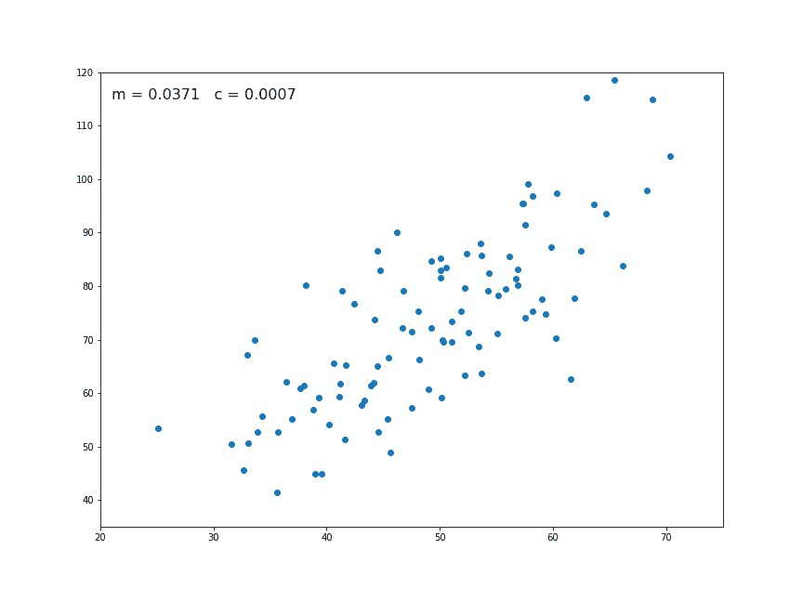


SDM – from a computer perspective
Machine’s learn by “trial & error”.
Computers excel at quickly trying everything
They find the best parameters so that:
Some measurement of error is minimized
E.g: || Y(parameters) – E(Y) || ≈ O
This is often called the “objective/cost/loss” :
Finding the best set of parameters becomes an optimization problem
As in, finding the optimal solution to a problem
$$Cost\left(m,C\right)=\left|Y_{(m,C)}−E(Y)\right|$$
Good choice!
The model “unit”
$$Y=m X+C$$
Parameters

Slide 15
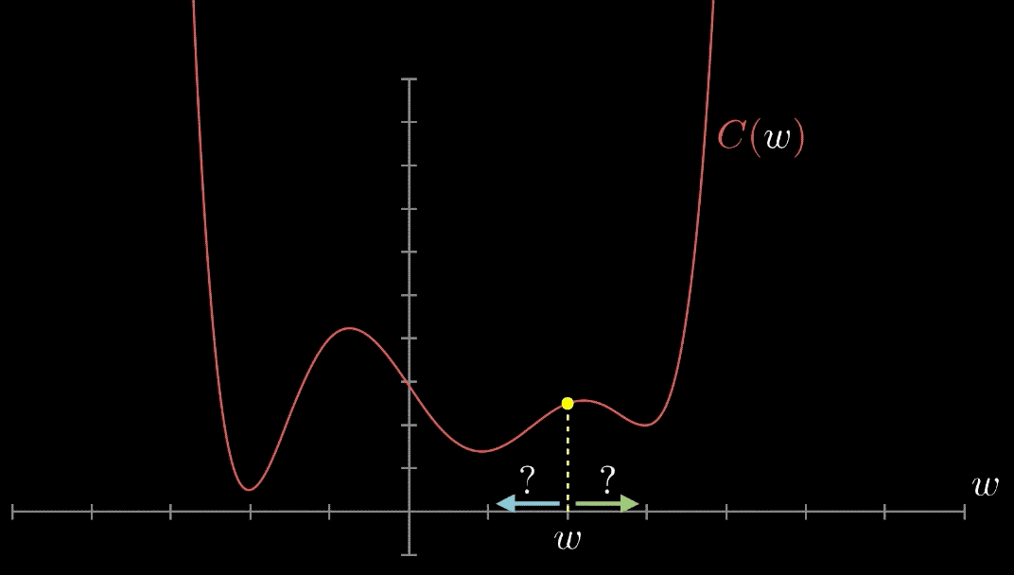
SDM – from a computer perspective
3blue1brown: "But what is a neural network?" - Youtube playlist
If we would just try different random sets of parameters we might never find the best solution
So computers generally start random but then in each iteration focus on the sets that have the best results

Slide 16
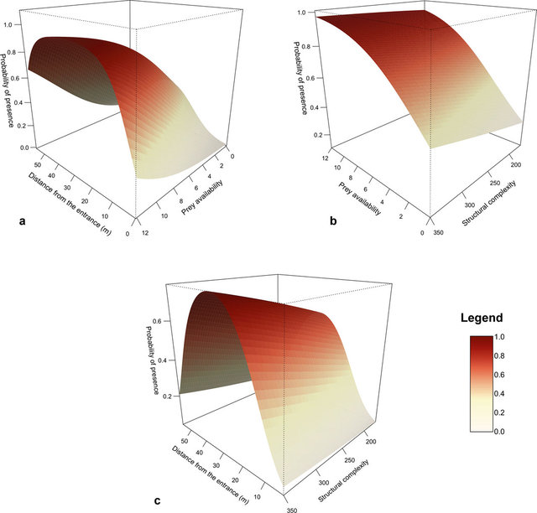
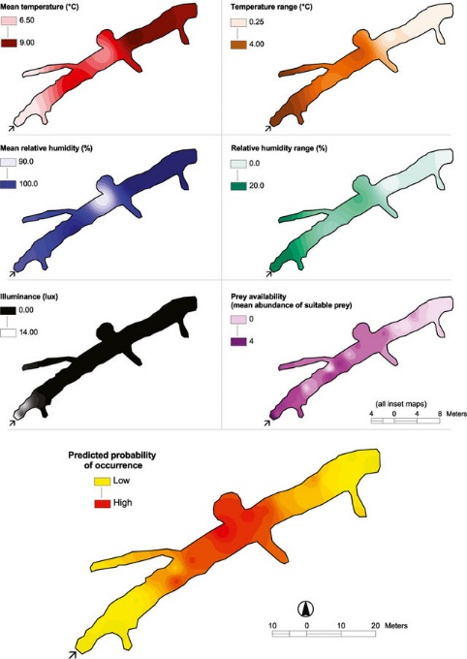

SDM – from a computer perspective
What we hope in the end is:
Learn a function:
P(Species|Env):
Geographical space
$$f\left(A,B,M\right)=P(species)$$
From: https://doi.org/10.1111/ivb.12113

Slide 17
Any questions? 30s

Slide 18
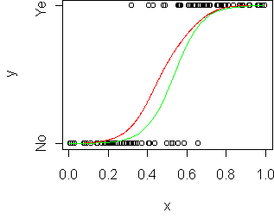
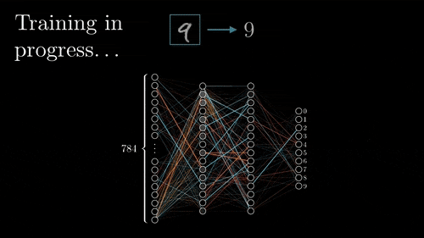
SDM – from a computer perspective
Bioclimatic envelope
Find best “rule” (aka threshods) that groups the data into similar sets
AKA: minimizing the impurity
Generalized Linear model (Logistic)
Finds the best parameters in a linear model structure that minimizes the ||Y – Y_expected||
Artificial neural networks
Sets of directed input/output linear models compressed into non-linear functions
Minimizes the difference between the ||Y – Y_expected||

Slide 19
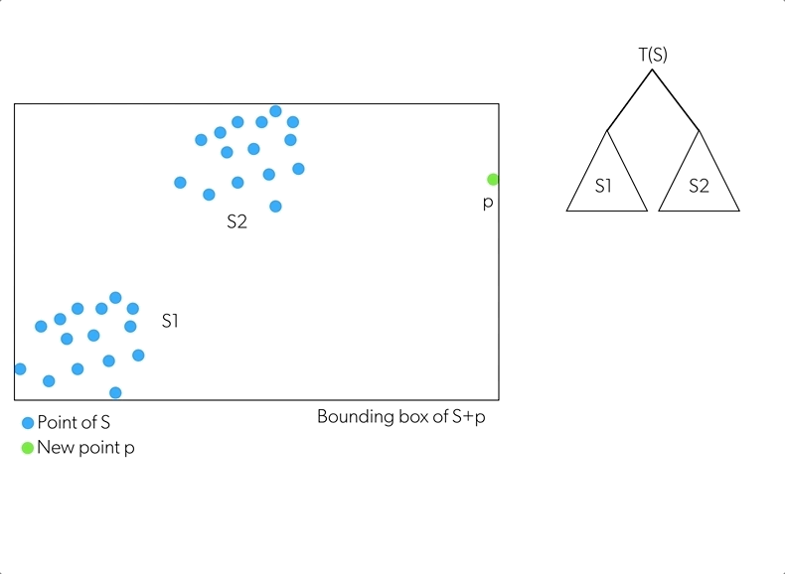
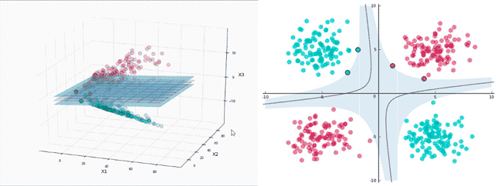
SDM – from a computer perspective
Random forests and Decision tree’s
Creates a hierarchy of rules that bins similar groups into the same by minimizing their impurity
Final output is a weighted sum of regression models on each bin
Support vector machine
Projects data into another space
Find the best n-dimensional plane that separates the data on the new space AKA maximizes separability
Many options, but our focus will in MAXENT

Slide 20
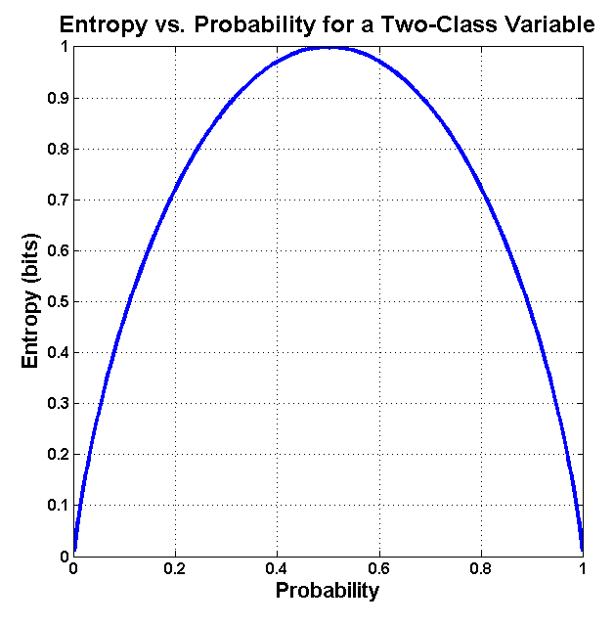
SDM – from a computer perspective
MAXENT
Maximum entropy principle
AKA the best model is the one that is constrained by the data but has the highest uncertainty
One of the benefits of MAXENT SDM is that they only needs presence points
Entropy can be defined as measure of disorder or uncertainty
If a coin toss is unbiased, each side has 50% probability
The entropy is maximized –> you are the most uncertain about the outcome
If the coin has a bias -> less entropy
Applying the Maximum entropy principle:
For any possible probability distribution, choose the most uncertain possible
OR: Maximize a measure of uncertainty

Slide 21
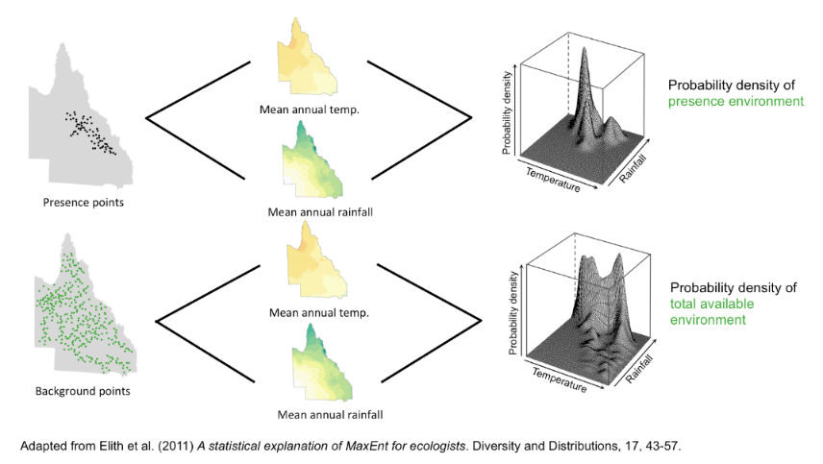
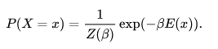
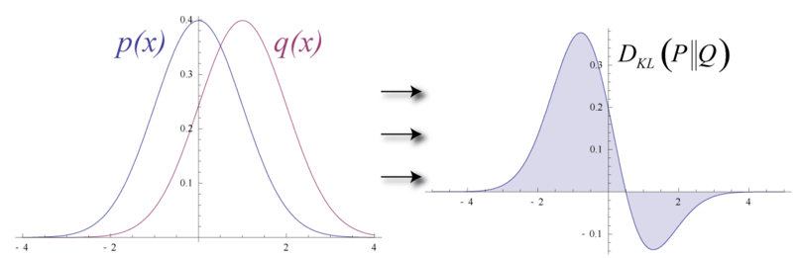
SDM – from a computer perspective
The most uncertain case for a species distribution:
A P(Species|Env) where it species is equally likely to occur in every location
In MAXENT: Background distribution
Imposes the structure of a Gibbs distribution to the environment:
MAXENT in machine learning:
Minimizes the difference between the observed distribution (presences) and the random background distribution (generated pseudo-absences)
Uses the relative entropy formula to measure their difference
From: https://onlinelibrary.wiley.com/doi/full/10.1111/j.1472-4642.2010.00725.x

Slide 22
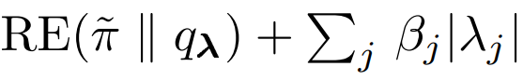
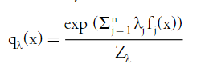
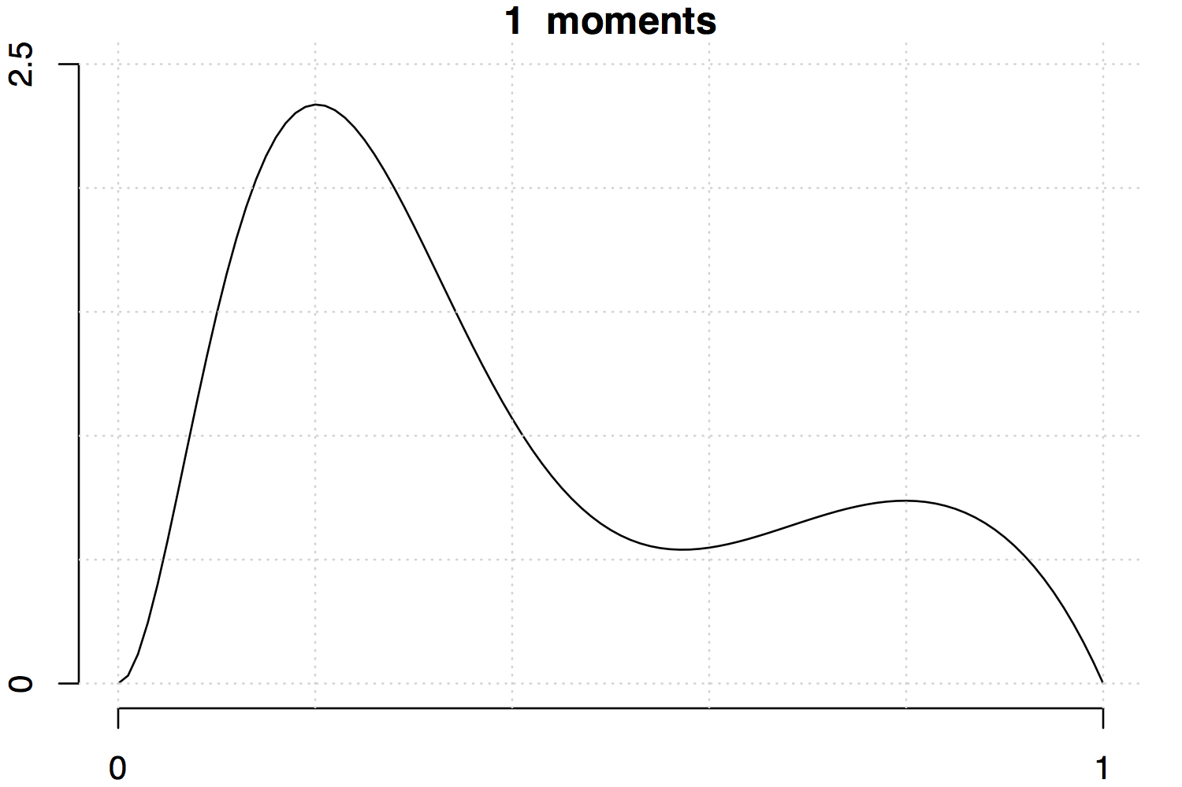
SDM – from a computer perspective
How does the model maths look like?
Deeply discussed in Phillips, 2004
RE is the relative entropy operator symbol
π-tilde – is the observed probability distribution
q_{λ}- is the background distribution parametrized by the Gibbs measure (also)
β_{i}|λ_{i}|-> are regulurization parameters to curb over fitting.
Notice, it changes only the parameters of the background distribution (q_{λ}) – and not the presence distribution
In SDM terms, MAXENT aims to:
Find the most uncertain distribution that is constrained by the observed presence points
Os, in other words: Starts with the most random distribution possible and finds the most random distribution possible that still predicts the presences
Regularization parameters
Feature weights
Normalization constant

Slide 23
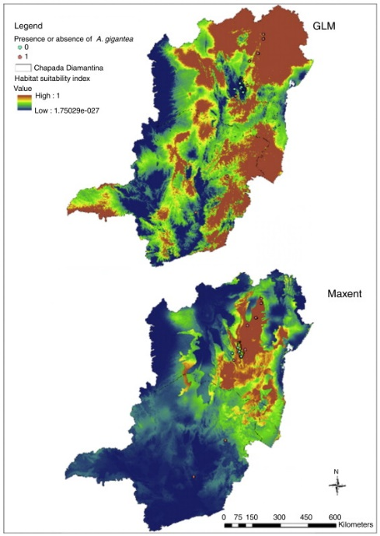

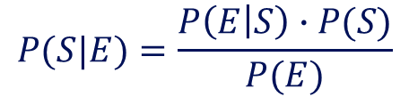
SDM – from a computer perspective
Mine both probability distributions from the data and learn the parameters
Apply the bayes theorem!
And voilá
$$P(S|E)=\frac{P\left(E | S\right)∙P(S)}{P(E)}$$
From: https://onlinelibrary.wiley.com/doi/full/10.1111/j.1472-4642.2010.00725.x
From: https://doi.org/10.1016/j.ncon.2015.03.001

Slide 24
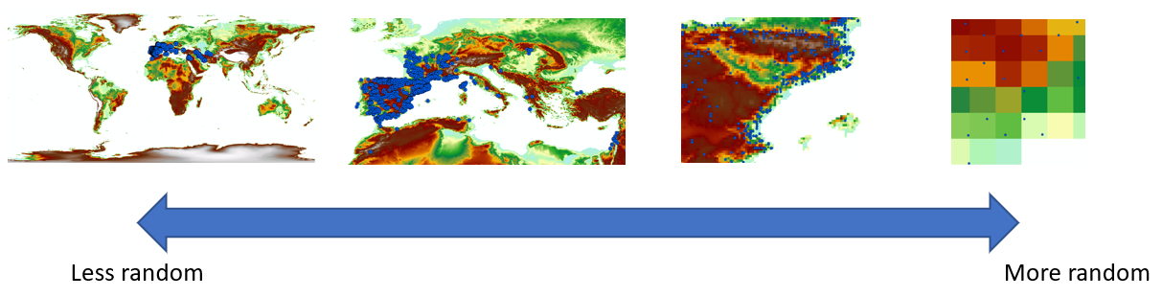
SDM – from a computational perspective
SDM can be limited by:
Environmental space not being representative of the process -> Problem of scale
The processes defining the distribution of the species vary according to the scale that you are using!
Machine learning, with bad data in will just produce a bad model -> it will learn how to do random predictions.

Slide 25
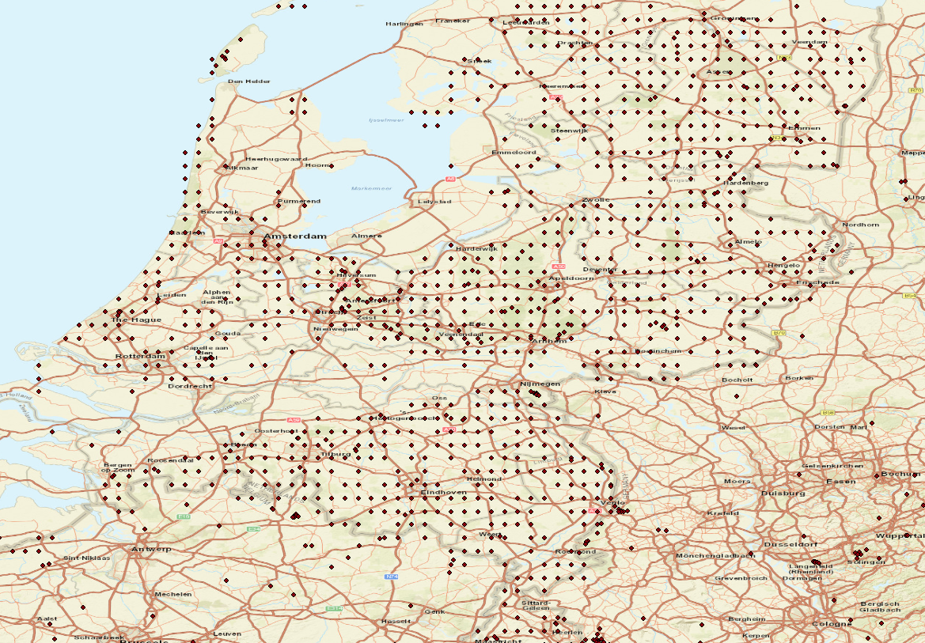
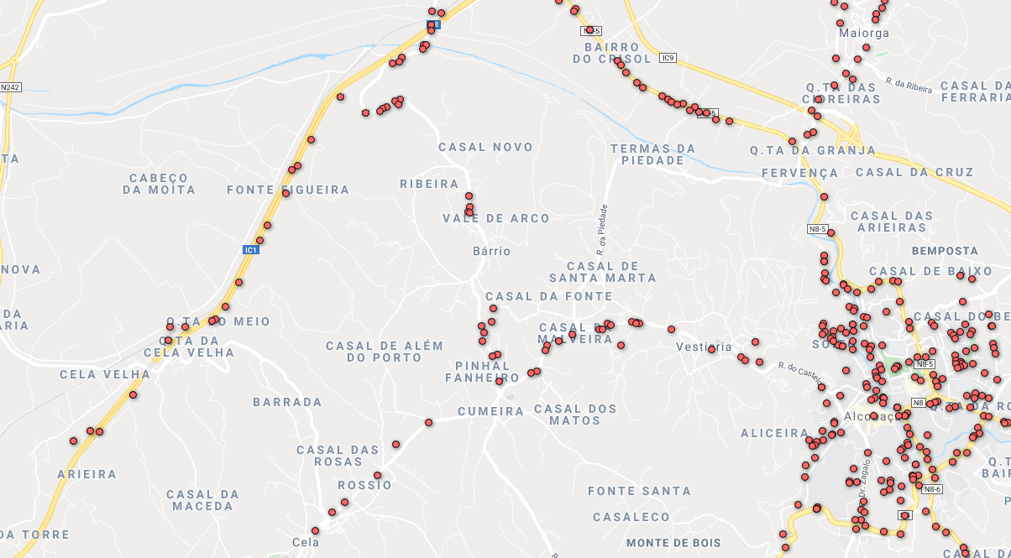
SDM – from a computational perspective
SDM can be limited by:
Spatial biases
Different sampling designs are also part of the processes that Machine learning learns
Meaning, if your data sampling strategy is biased, your model, will also learn that bias

Slide 26
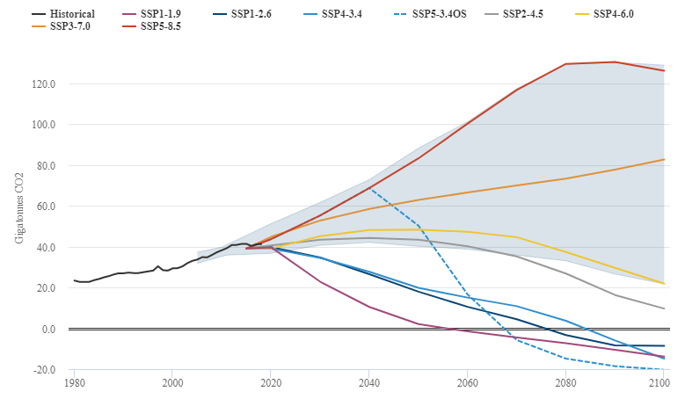
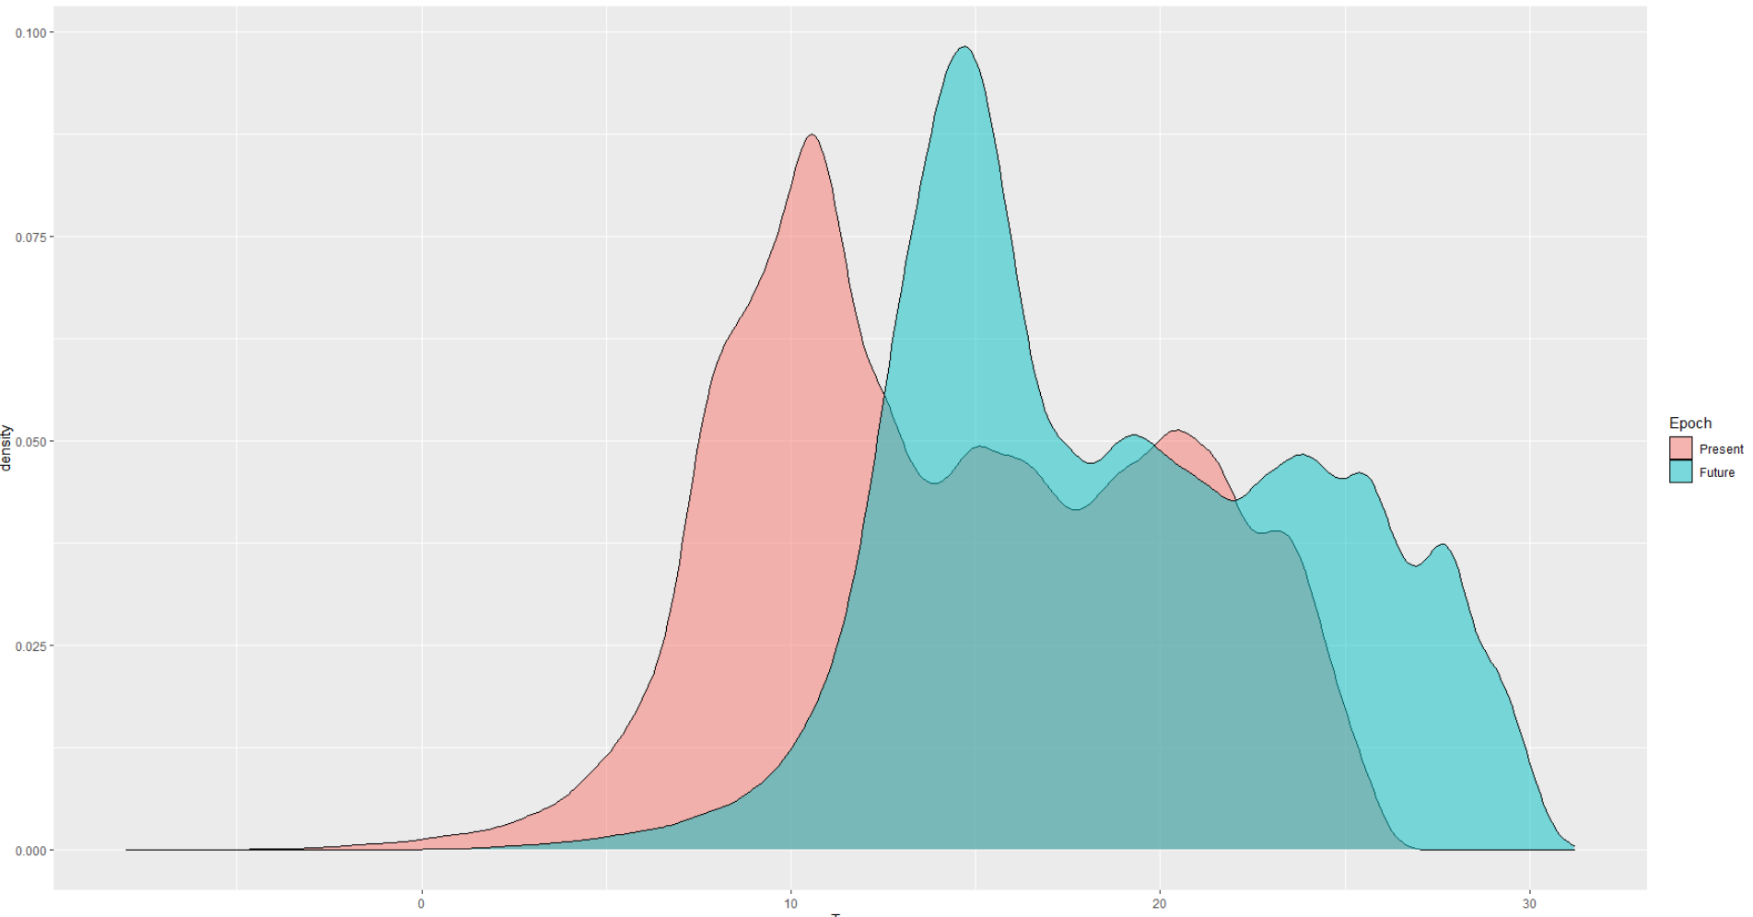
SDM – from a computational perspective
SDM can be limited by:
Non-analogous conditions in time
Present vs 50 years in the future (rocky road scenario!)
Above we see a shift both in the distribution (arrow) as well as a range of values outside the training range(red box) for the Mean Annual temperature in the study area
These non-analogous conditions imply that your model is extrapolating on that range

Slide 27
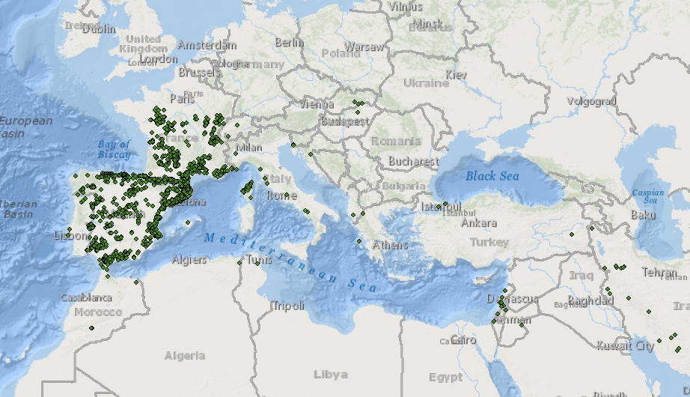
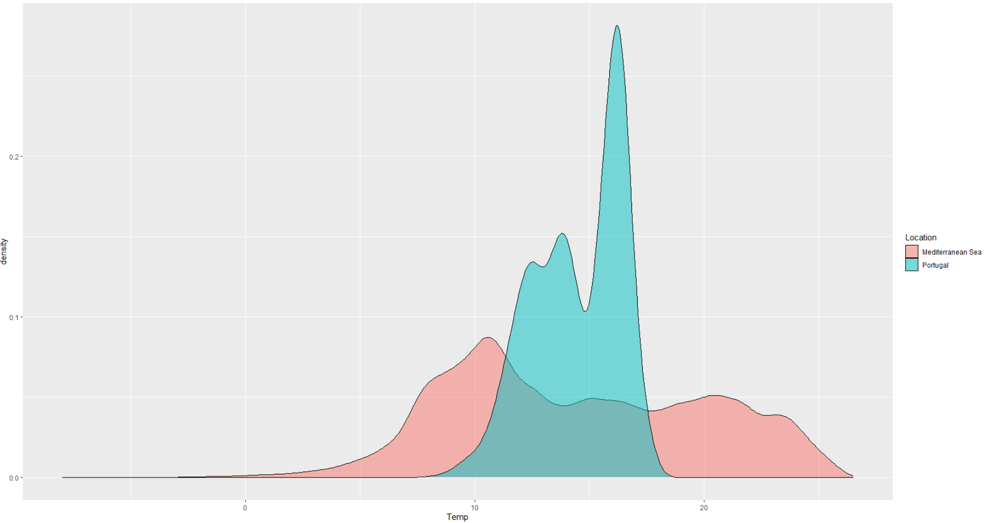
SDM – from a computational perspective
SDM can be limited by:
Non-analogous conditions in space
Temperature distribution for Portugal and the Mediterranean
A model trained in Portugal would have to extrapolate if used in the Mediterranean regions.
Mismatch is an environmental space problem occurs frequently with Invasive Alien Species

Slide 28
SDM – from a computer perspective
So in summary:
All ML models have a set of parameters and structure which is optimized to fit observations
Machine learning is able to “understand” the processes but can’t (necessarely) explain them to humans
The ML behaviour is fully driven by:
Model structure
Parameter
Cost function and optimization method
At the end of the procedure you have a function (f) that:
maps an n-hyperdimensional space onto another n-hyperdimensional space
In SDM: n-Environmental space to probabilistic space -> which then can be projected to a Geographical space

Slide 29
SDM – from a computer perspective
Not all models work the same:
MAXENT works “fine” even with reduced sample numbers – maximum entropy principle
Error sources:
Spatial biases: are a process that can (will) get learned by the algorithm
Scale: affects the driving spatial processes defining the distributions -> your model learns what you give it
Non-analogous conditions in time & space: The model has to extrolate
Most important for a good SDM model:
Occurrence data reflecting the ecological niche of the species
A scale that reflects the ecological processes that you want to investigate <- one of the big problems
A model that “maximizes” your objectives: Excellent predictions? Deep Learning

Slide 30
Any questions? 1min
Next: Validating your model

Slide 31
Remember where we are:
Occurrence
Algorithm
Validation
Predictions
Performance
Enviroment
How to validate a model?
How to interpret the relations on the data?
What are the limitations of the model?

Slide 32
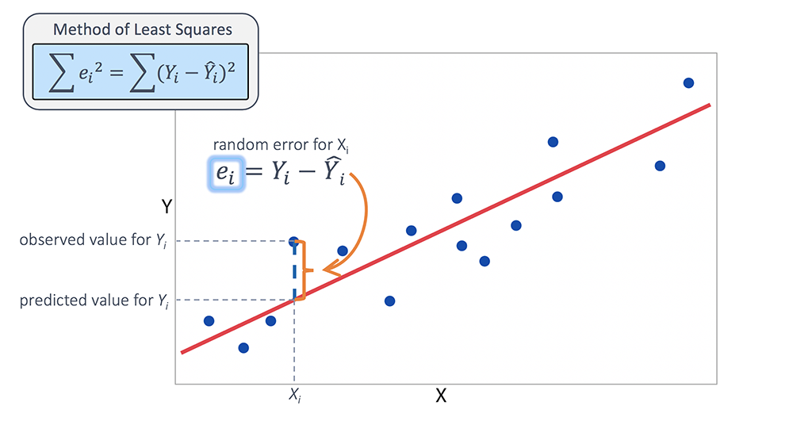
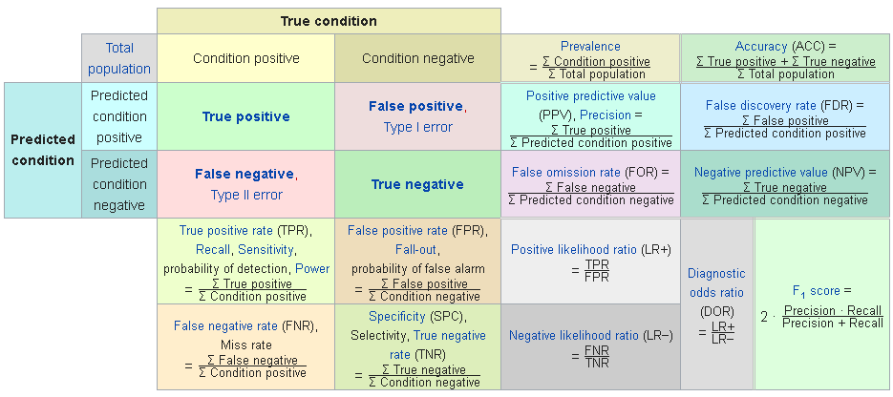
SDM – Model validation & performance
In ML there are two main types of validations:
Regressions errors: Root mean squared error, Mean absolute error etc
Classification errors: Overall acuraccy, K, jaccard etc.
SDM is a supervised classification exercise
Binary: the species is either Present or Absent
Even if in some cases, the output is a Probability
Threfore, use classification validation metrics
Classification errors:
Mostly based on the concept of Confusion matrix (next)

Slide 33
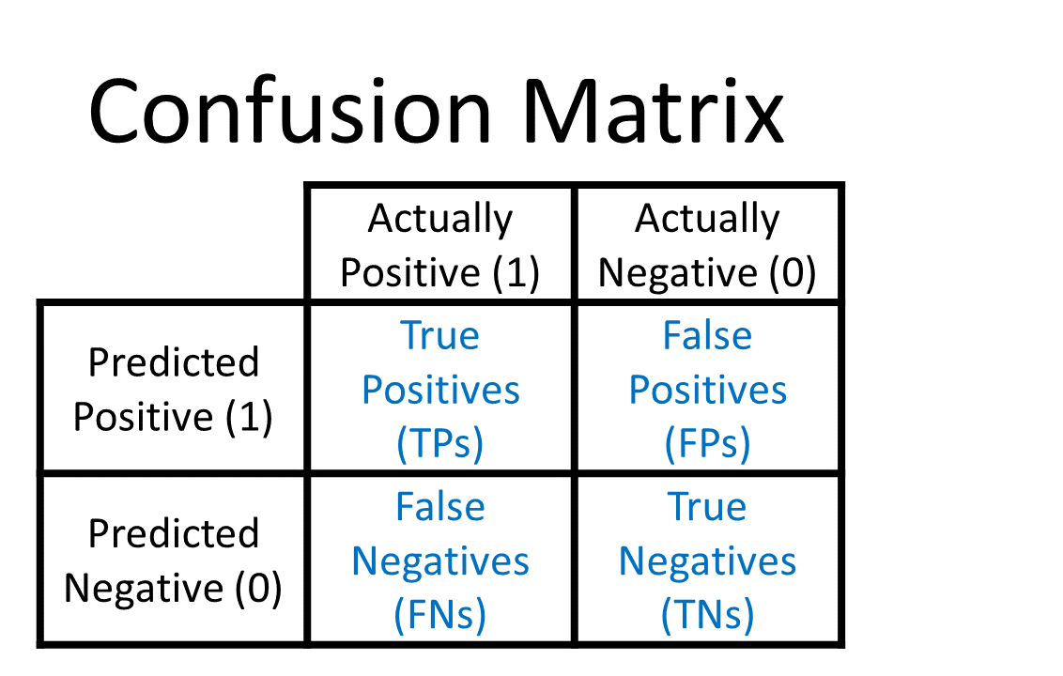
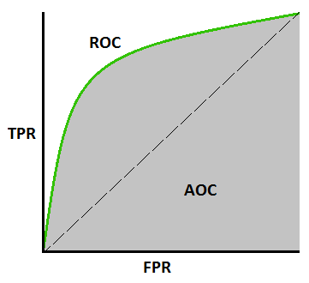
SDM – Model validation & performance
Confusion matrix: (or error matrix)
Shows the agreement between our predictions and the validation data
Requires Presence/Absence data for validation
Quantifies agreement/disagreement
Type I error -> our model predicted presence where it is absent
Type II error -> our model predicted absence where it is present
MAXENT:
Only needs Presence data – can’t use the confusion matrix
Instead: Area under the curve of the Receiver Operating Characteristic
Type I error
Type II error

Slide 34
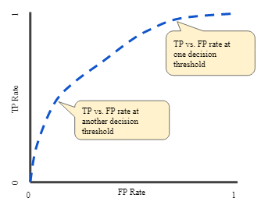
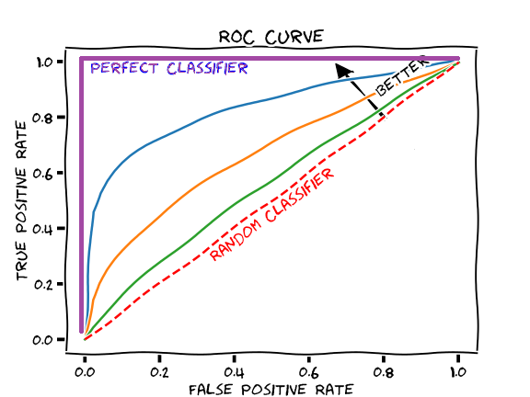
SDM – Model validation & performance
Receiver operating characteristic curve (ROC)
Ilustrates the ability of the binary classifier by varying the probability threshold
Notice: both axis vary from 0 to 1
TPR = Sensitivity
Tells something about the ability to predict true positives
FPR = 1 – Specificity
Tells something about the ability to identify true negatives
Area-under the curve (AUC):
Integral of the area under the ROC curve.
When the discrimination power is perfect: AUC=1

Slide 35
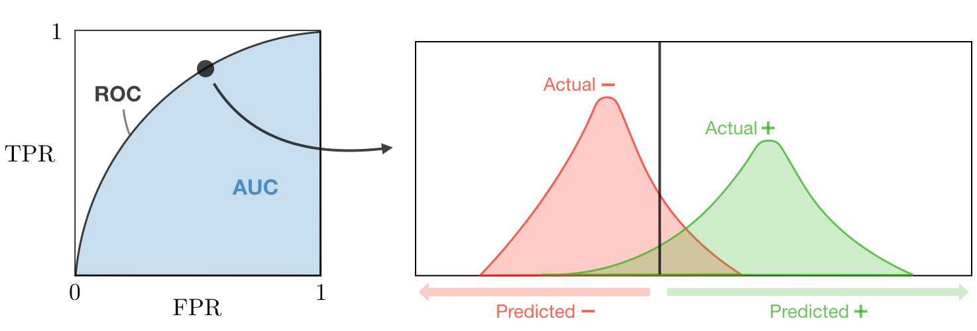
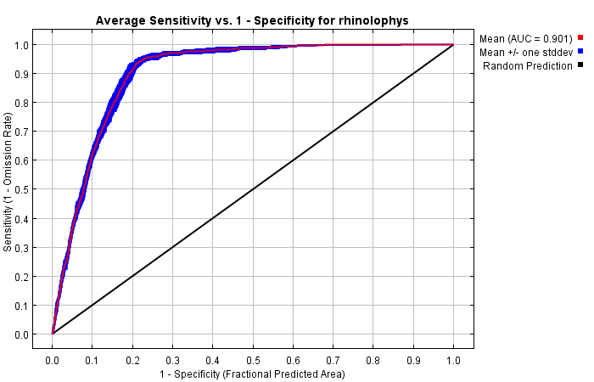
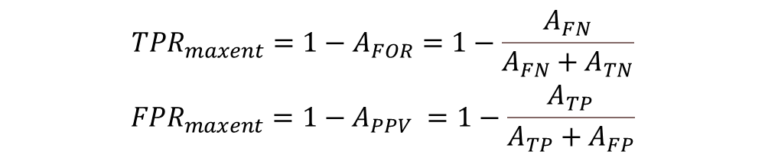
SDM – Model validation & performance
Problem still remains in MAXENT!
When no Presence/Absence data is available.
MAXENT uses predicted areas to aproximate the AUC-ROC:
Where the A_{ij} represents:
The actual geographical area predicted as FN, TN, TP,FP
$$\begin{matrix}{TPR}_{maxent}=1−A_{FOR}=1−\frac{A_{FN}}{A_{FN}+A_{TN}} \\ {FPR}_{maxent}=1−A_{PPV} =1−\frac{A_{TP}}{A_{TP}+A_{FP}}\end{matrix}$$

Slide 36
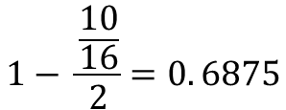
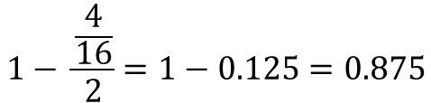
SDM – Model validation & performance
“When AUC statistics are applied to presence-only data and pseudo-absences, the maximum achievable AUC value is no longer 1, BUT 1- a/2; where a stands for the true species’ distribution, which we typically do not know” (Phillips, 2006)
Less prevalent
More prevalent
x
 |  | x
x
 | x
x |  | x
 | x | x | x
x |  | x | x
 | x | x
$$1− \frac{\frac{4}{16}}{2}=1−0.125=0.875$$
$$1− \frac{\frac{10}{16}}{2}=0. 6875$$
Less prevalent
More prevalent

Slide 37
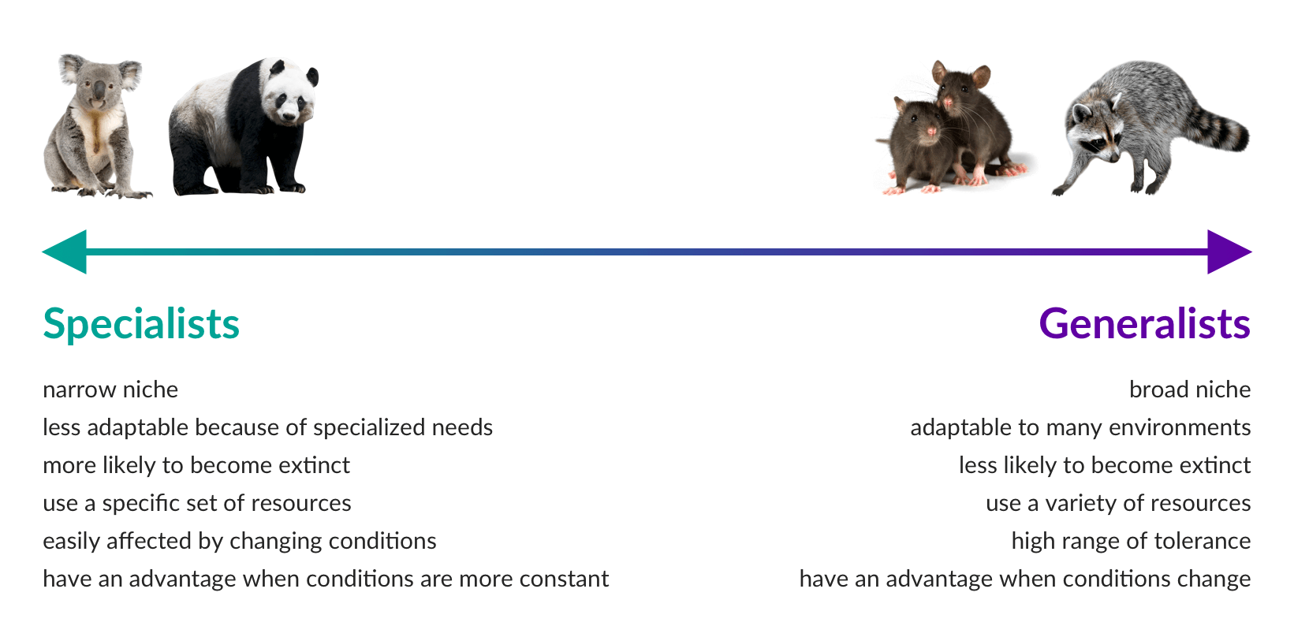
SDM – Model validation & performance
The implication that the AUC is vulnerable to generalist/specialist species
And also highly sensitive to the Scale:

Slide 38
SDM – Model validation & performance
In summary:
SDM can and should be validated using regular classification error metrics when possible
MAXENT is a special case where absence data is “not available” –> AUC-ROC used as an alternative
MAXENT custom AUC-ROC is provided by the software
Don’t worry!
Both AUC are highly affected by prevalence & scale
Are there other methods?
Of course, many. E.g. a Leiden researcher proposed a Null-model approach (Neils Raes, 2007)

Slide 39
Any questions? 30s

Slide 40
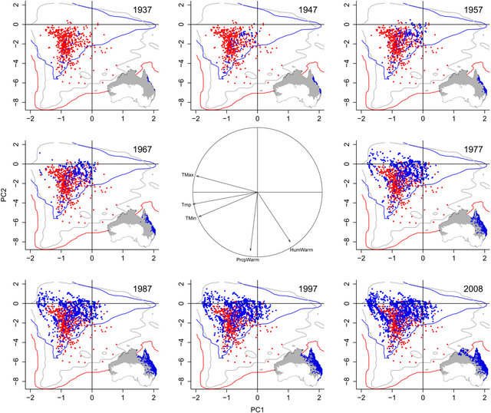
SDM – Model validation & performance
Non- analogous conditions
In time (e.g. Climate change)
In space (e.g. A new geographical region)
Two “unspoken” problems this lecture were:
What if the niche is yet stable?
What if the historical data is affected by climate change?
Again, different methods/diagonostics but the focus in MAXENT:
Model response curves & clamping
Multivariate Environmental Similarity Surfaces (MESS) & Most dissimilar variable (MoD)
Variable importance & Jacknife testing
From: https://www.pnas.org/content/111/28/10233

Slide 41



SDM – Model validation & performance
Model responses
MAXENT provides a univariate probability response plots
These show how probability varies according to each enviromental factor
You can explore these outputs to know if you’re model was trained close to the limits of the species range
Clamping:
Tells MAXENT what to do when the variable is outside the training range
Good example!
“Extrapolate” option
“Fade by clamping” option
“Clamping” option
Clamping

Slide 42


SDM – Model validation & performance
Multivariate Environmental Similarity Surfaces (MESS)
Red – most dissimilar
Blue – most similar
Most Dissimilar Variables (MoD)
Maps which of the various environmental had the most dissimilar MESS for that particular location
These models can/should
Be used to identify where we should be suspicious of our model performance
Notice: Clamping might (will) affect these surfaces!
Algorithms described in: (Elith,2010; Supporting information)

Slide 43

SDM – Model validation & performance
Variable importance:
These provide an estimate of how significant X variable was for the MAXENT model
Critical for ecologists: they provide information about which environmental variables mattered for the model
Percent contribution:
Tracks changes on the Regularization parameters during trainng
Normalizes everything to provide a % value
Permutation importance:
Changes in training AUC by excluding/including the given variable
Normalizes everything to provide a % value
Take note:
% contribution ≈ Permutation importance is a good sign
These estimates are highly affected by autocorrelation between environmental variables
Regularization parameters

Slide 44



SDM – Model validation & performance
Jacknife testing
Asses the variation in accuraccy (aka, gain or AUC) if a model is ran using only variable X or excluding variable X –> jacknife
The “non-used” variables are set to the mean value of the distribution
Mostly the same information as variable importance
Remember: Ecologists should care for what drives the distribution
MAXENT provides 3 versions:
Based on the training acuraccy gain
Based on the test accuraccy gain (data that was left out!)
Based on the AUC <- This is the most helpful as it relates directly with the AUC-ROC report

Slide 45
SDM – Model validation & performance
In summary:
Predictions on non-analogous conditions – where are they and how to deal with them?
Species with unstable niche (e.g. exotic species) often break the assumptions of Hutchinson niche theory
MAXENT diagnostic's:
Response curves –> Indication of how your model responds to the environmental variable
MESS & MoD -> Indication of where and why is your mode extrapolating
Variable importance -> indication of which variables are more important for the species distributions
Jacknife testing -> Same as above
Your model performance should be interpreted using all the diagnostics offered:

Slide 46
Two case studies:
Shameless self promotion!

Slide 47


SDM – Model validation & performance
Using Citizen science to improve SDM (César de Sá, 2019)
Compared how data from citizens coupled with scientific surveys improves SDM coverage for invasive alien species
Identified areas of highest surveillance priority (aka likelihood of invasion but no data is available:

Slide 48



SDM – Model validation & performance
Predicting the distribution of a biocontrol agent introduced in Portugal (Dinis, 2020)
The first biocontrol introduction in continental europe!
Measured niche overlap to assess if there is significant change between native and invaded areas

Slide 49
Thank you!
Q & A time
In the afteroon, you get to try this on your SPECIES!

Slide 50
Setting up MAXENT & JAVA
And starting by Downloading the climate data during lunch

Slide 51



Setting up Java
For Java:
Go to https://www.java.com/en/download/help/download_options.xml
Follow the steps to download and install the software for your operating system
Unsure about your OS? In windows, go to your system properties:
Check Java installation:
Go to the search box and write “Command line” (or in your own OS language)
On the DOS box that opens, type: java – version
If all is well, you will have a similar output

Slide 52


Setting up MAXENT:
Go to https://biodiversityinformatics.amnh.org/open_source/maxent/
Tell them a bit about yourself
You can lie, but remember it is a sin
Download the software and unzip it to a folder
Click on the .Jar file to activate
If you see the screen, should be fine
PS: Would be nice to cite them on your report

Slide 53
Downloading the climate data
Go to the manual
It’s already in brightspace!
Follow the steps to download the climate data detailed there
In summary:
Go to https://www.worldclim.org/
Download:
Historical bioclimatic data (bio 5m) at 5 minutes resolution
Future scenario bioclimatic data (bc) data: IPSL-CM6A-LR / SSP370

